Slide 1

Microsoft System Center 2012 R2 Configuration Manager Training

Slide 2
System Center 2012 R2 Configuration Manager Training Overview
Explain the Application Delivery Workflow
Offer insight into key functions for daily operations
Brief overview of the Infrastructure Architecture
Complete a live demo (CHG48085 – Deploy VPN Client)
Demo in System Center Configuration Manager Console
What about Casper?
Common troubleshooting and Q&A

Slide 3








User based Application Delivery
Define application once per version
Streamlined updates
Inventorying and user affinity
Supersedence for 0-day exploit
Delivery Evaluation Criteria
User
Machine Name
Groups
< >
User/Device Relationships
Primary Devices
MSI
EXE
Non-primary Devices
Temporary assignment
“Shared” licenses
Asset Management

Slide 4

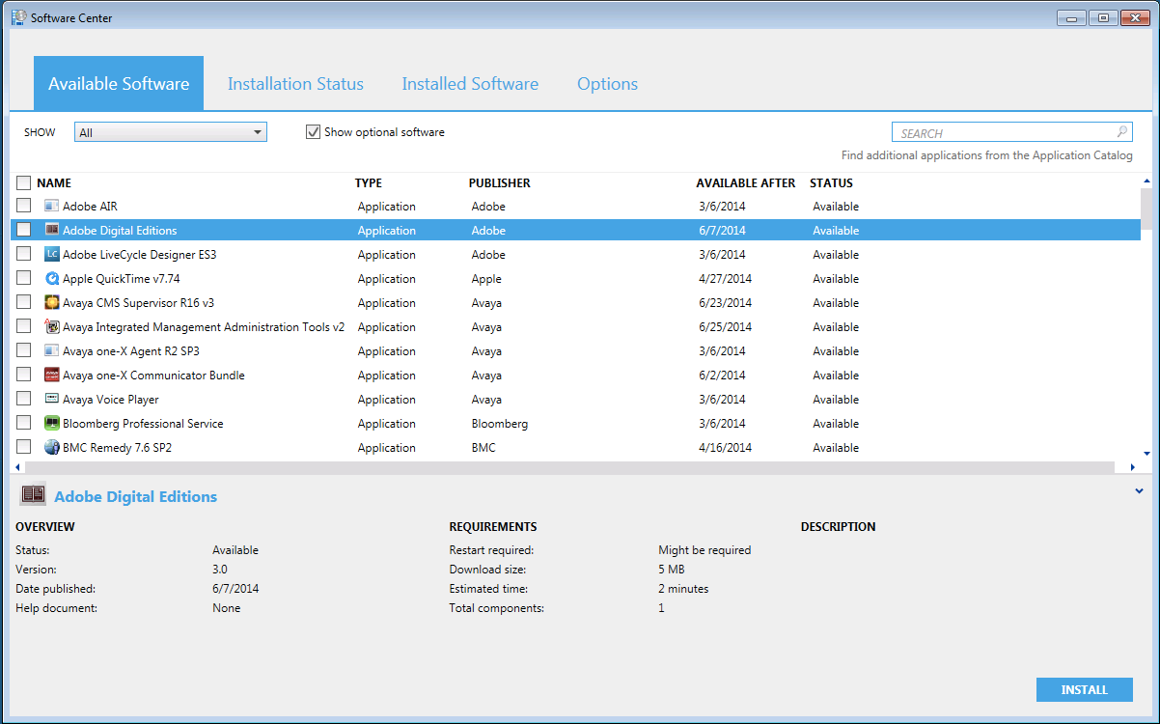
User based Application Delivery Self-Service Model and ITG Applications
Administrators (IS or “Tiger Team”) will publish software titles to catalog via the SCCM console and add meta-data for high-level user interface
Admin
Users can browse, select and install/uninstall directly from Software Center Catalog
How? Application model determines format and policies for delivery
User

Slide 5

Our Client’s End User Experience (Customized)
Setting the expectation for the end user
Client system based Software Center
Is currently available on more than 750+ machines to date
Easily search, install, or upgrade software or applications
User preferences to control ConfigMgr on individual machines:
My business hours – used to control when to install software or updates
Presentation mode – don’t disturb (notify or update) when presenting
Remote control settings – (locked) admins can remotely administer machines

Slide 6




Application Delivery and Maintenance Internal Management Model
General Information
Application or Package
Administrator Properties
End User Metadata
Keep applications organized and managed
The “friendly” information for your users
< >
Deployment Type
Detection Method
Install Command
Requirement Rules
Dependencies
Supersedence
MSI
Is app currently installed?
Windows Script
Command line and options or toggles
Windows Installer
Allowed/Denied to install application
CAB
Applications that must already be present
Application version control and update management

Slide 7
Application Delivery and Management
Manage applications with built-in mechanisms [not manually (or Service Now)]
Application Management:
Detection method – re-evaluated for presence:
Required application – reinstall if missing
Prohibited application – uninstall if detected
Requirement rules – evaluated at install time to ensure the app only installs where it can and is permitted to
Dependencies – relationships with other apps that are all evaluated prior to installing anything to ensure no conflicts
Supersedence – relationships with other apps that should be uninstalled prior to installing anything
Notes:
Dependencies: Detect if required applications are present, and optionally install if not detected
Supersedence: either run the install command line, or run the uninstall first, then the install
Revision: keeps a history of changes to an application and allows for reverting back to the older version

Slide 8
Operating System Deployments
Lite-Touch imaging process
No more “SneakerNet”
USB Manual Deployment available
PXE Boot from 202 Workbench
As-needed software and updates deployment
Deploy an image then update the software and/or OS
Advertisements based on group/machine type
Full support for Windows 7 x86/x64 and Windows 10 x64 for most platforms
Notes:
Mac Capabilities:
Discovery – Discovers Mac OS X system in Active Directory and through network discovery
Hardware Inventory – Provides hardware inventory and auditing of computers running Mac OS X, including a list of installed software similar to add/remove programs for Windows systems.
Settings Management – Ensures computers running Mac OS X comply with company policies using scripts and preference list management.
Application Deployment – Distributes required software via app model.
Software Updates Management – Distributes patches utilizing Software Distribution and Settings management features.
Linux Capabilities:
Hardware Inventory
Software Inventory (via Hardware Inventory)
Software Distribution
Endpoint Protection (Linux Systems)
Unified Reporting
Maintenance Windows

Slide 9

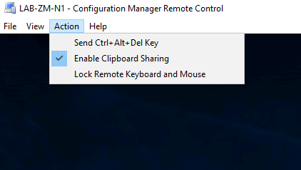
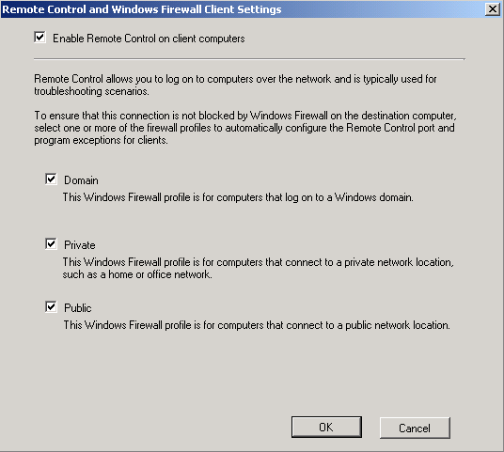
Remote Control & Assistance
What’s So Special?
Ability to send Ctrl-Alt-Del keystroke to host device
Granular client settings per collection
Lock keyboard and mouse
Share clipboard with host
Ability to create firewall exception rule

Slide 10

What about our Infrastructure?
Primary Site (Prometheus)
Client management and settings
Delegated administration
60th Street Computer
Primary Site
Secondary Site
Client Computers
Content routing
Distribution points
Only at 60th Street
Directly Assigned
Report to Primary Site
Secondary Server (Hecate)
Client Computer (Uris)
Client Computer (Warren)

Slide 11
Live Demo – CHG48085 – Deploy VPN Client
We will be using the System Center Configuration Manager 2012 R2 Infrastructure to deploy the new Cisco ASA VPN client to all laptops in the environment.

Slide 12
What about Casper?

Slide 13
What about Casper?
No Centralized OS Deployment (native MacOS recovery system)
Cannot deploy applications on demand (coming soon)
All functions are done through web interface
Does not have remote control functionality (GUI, ssh permitted)

Slide 14
Microsoft System Center 2012 R2 Configuration Manager Training

